Slide 1
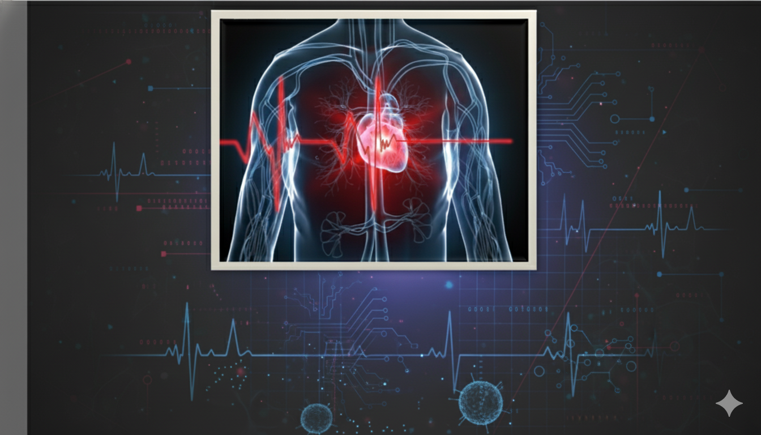
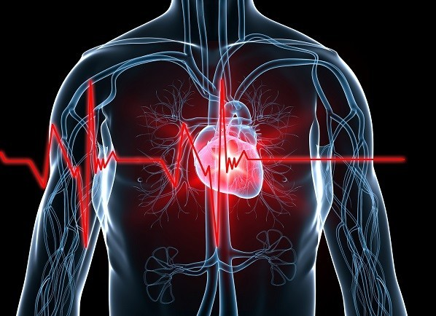
HEART DISEASE PREDICTION USING
LOGISTIC REGRESSION
Presented By: Auric Dutt
Guide Name: Miss Naina Devi

Slide 2


CONTENTS
Problem Statement
Solution
Technologies Used
Data Pre-processing & Visualization
Model Building & Evaluation
Working of Web App
Applications
Future Scopes
Issues Faced
Conclusion

Slide 3

PROBLEM STATEMENT
Heart disease remains one of the leading causes of death worldwide. Early detection and timely diagnosis can significantly reduce the risk of severe complications and mortality.
However, manual diagnosis often depends on multiple clinical parameters, which can be time-consuming and prone to human error.
Therefore, there is a need for a reliable machine learning-based predictive model that can analyze patient data and help in predicting the likelihood of heart disease efficiently and accurately.

Slide 4
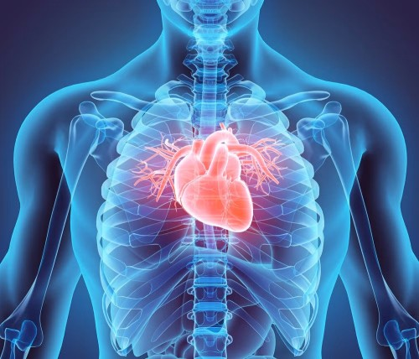

SOLUTION
To address the challenge of early heart disease detection, a machine learning-based web application was developed.
The model uses patient medical data to predict the likelihood of heart disease using Logistic Regression, achieving around 90% accuracy.
A Streamlit dashboard was created to make the system interactive — allowing users to input health parameters, visualize insights, and get instant predictions.
This solution aims to assist healthcare professionals and individuals in making faster, data-driven decisions.

Slide 5



TECHNOLOGIES USED
Programming Language: Python
Libraries & Frameworks: Scikit-learn, Pandas, NumPy, Matplotlib, Seaborn
Web Framework: Streamlit
Data Visualization: Matplotlib, Seaborn
Model Used: Logistic Regression
Tools & Platforms: Jupyter Notebook, PyCharm, Streamlit Community Cloud, GitHub

Slide 6
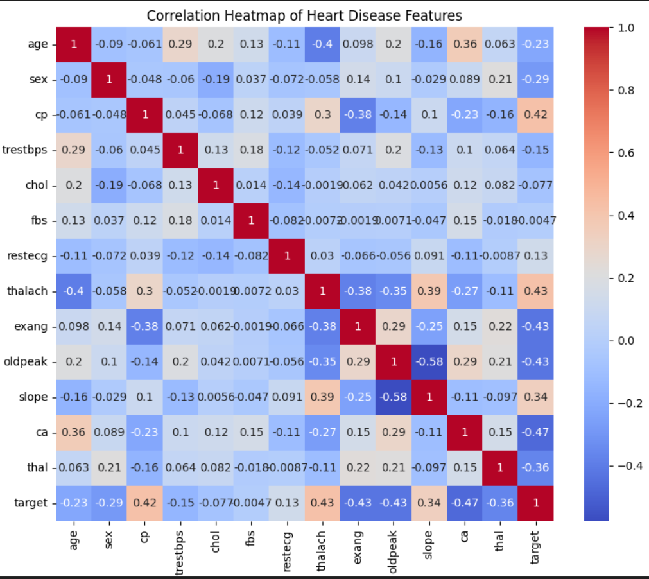
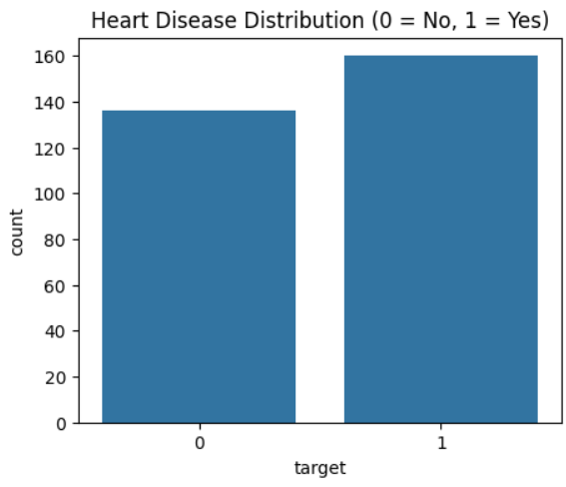
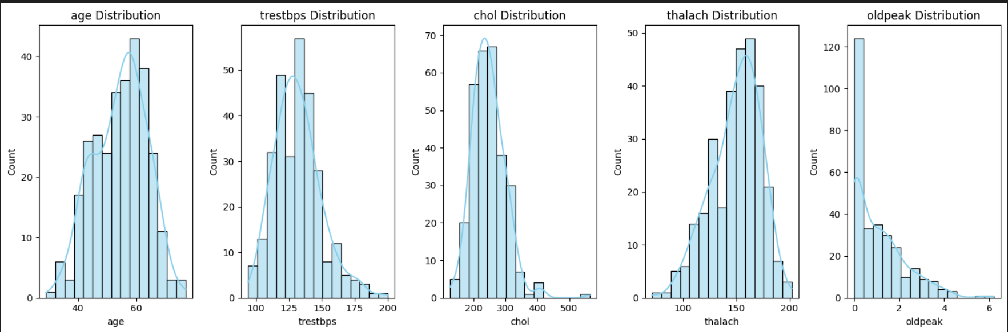
Data Pre-processing & Visualization
Dataset: Heart Disease UCI Dataset (14 features, 303 records) used to predict the likelihood of heart disease.
Before model training, the dataset was cleaned by handling missing values and converting categorical variables into numerical form.
Data visualization was performed using Matplotlib and Seaborn to explore patterns and relationships between features.
Important insights like the correlation between cholesterol, age, and heart disease presence were identified, helping in feature selection and understanding data trends.

Slide 7
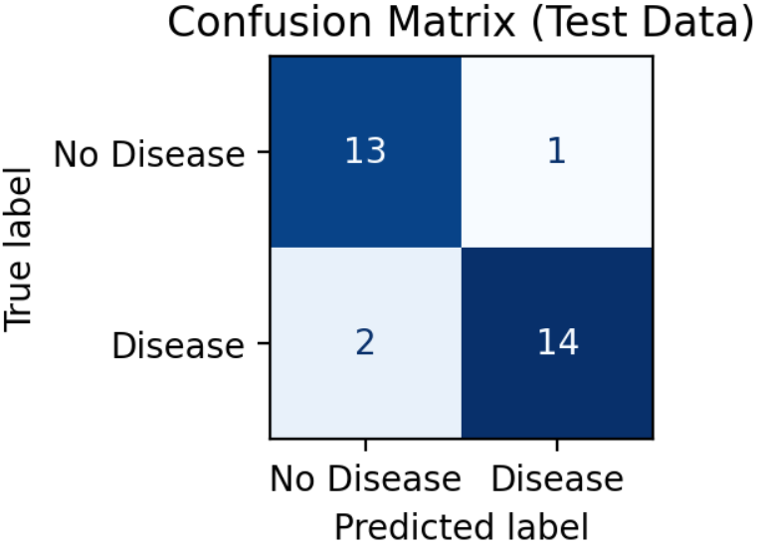
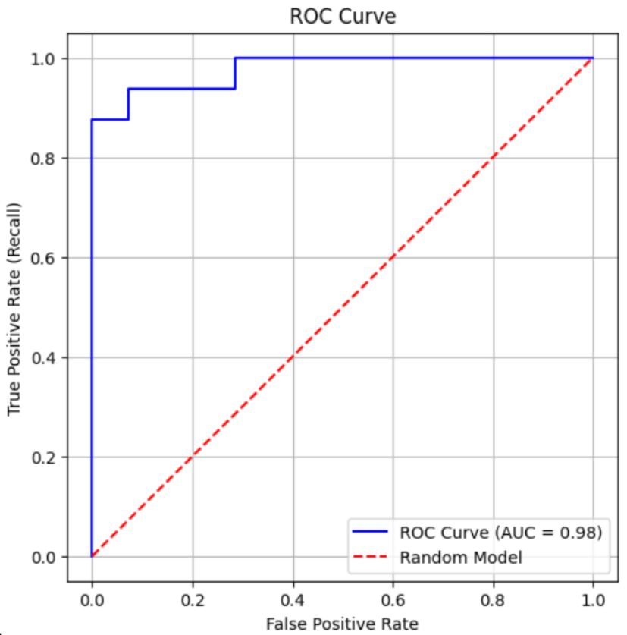
Model Building & Evaluation
The dataset was divided into training, testing, and cross-validation sets to ensure the model’s performance was both accurate and reliable.
A Logistic Regression model was trained using the training data, while the testing set was used to evaluate how well the model performs on unseen data.
Cross-validation was applied to further validate the model’s consistency and to prevent overfitting.
The model’s performance was assessed using metrics such as Accuracy, Precision, Recall, and F1-Score.
Visualization tools like the Confusion Matrix and ROC Curve were used to interpret results effectively.
The model achieved an AUC score of 0.98, indicating excellent ability to distinguish between patients with and without heart disease.
METRIC | VALUE
Accuracy | 0.90
Precision | 0.93
Recall | 0.87
F1 Score | 0.90

Slide 8
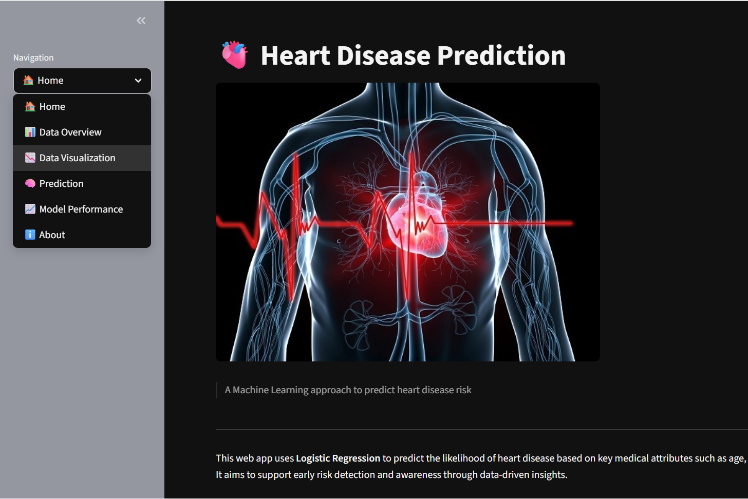
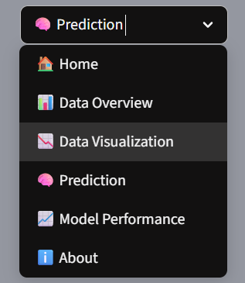
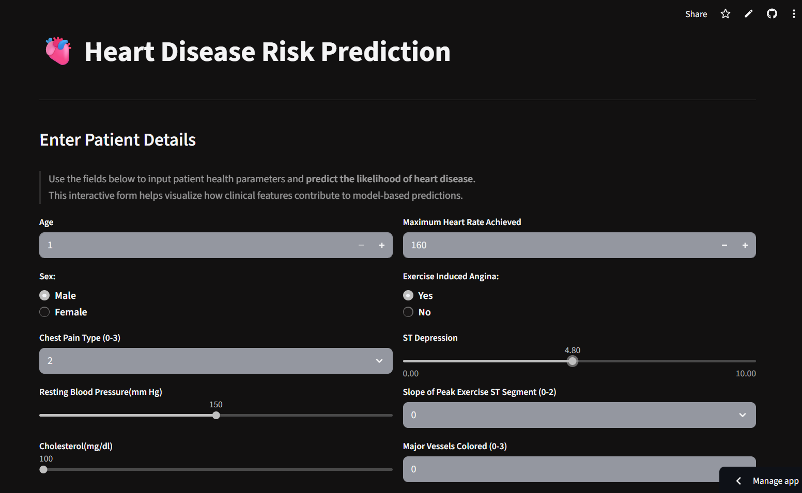
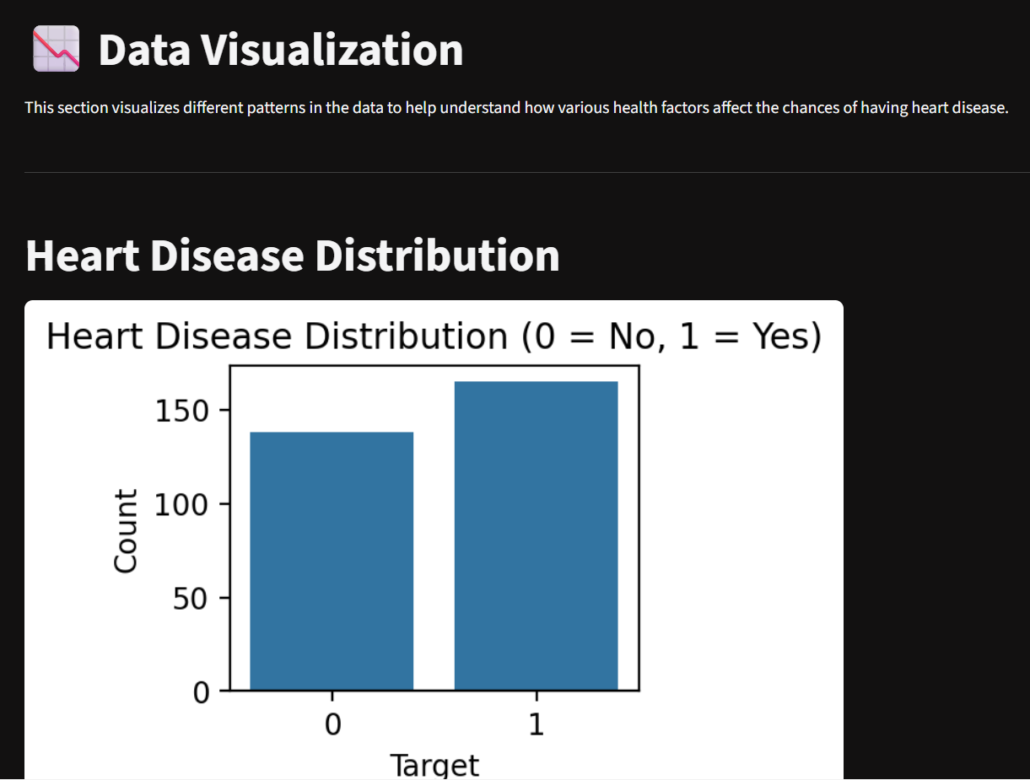
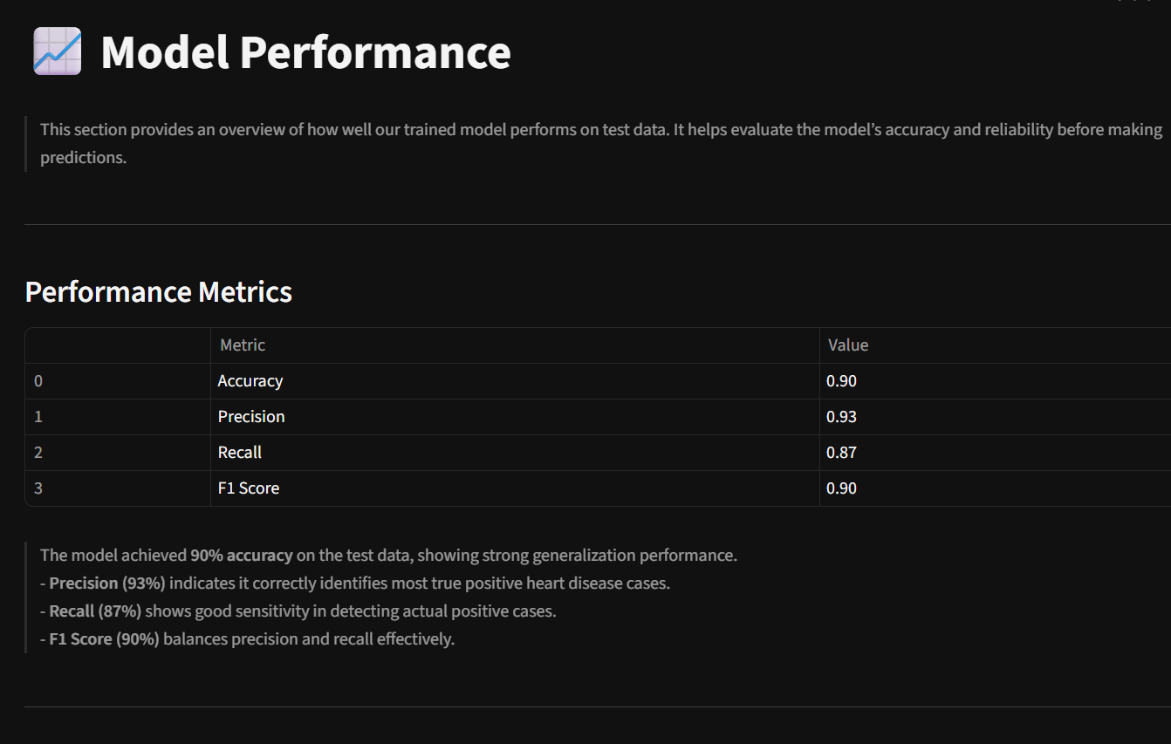
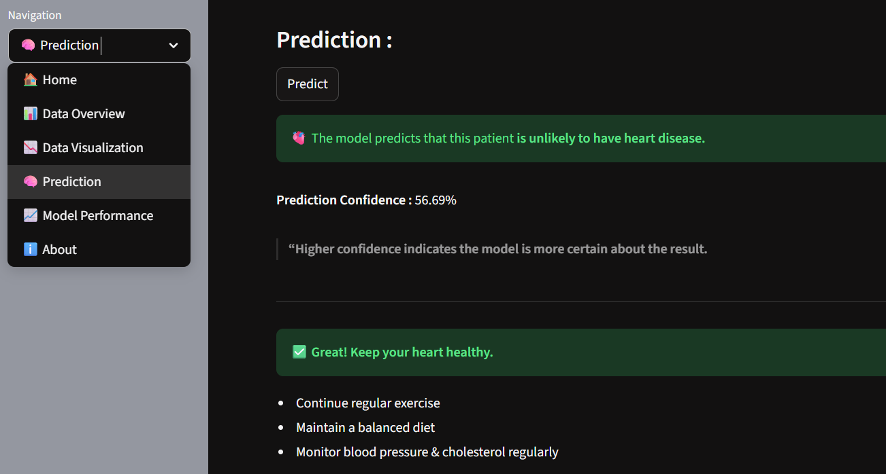
Working of Web App
Demo Video Link: https://drive.google.com/drive/folders/1EHpA4BfrjNZA9YOwOYMGPpOJvOMC2kN6?usp=drive_link
Screenshots:

Slide 9

APPLICATIONS
Assists doctors in early diagnosis and decision-making.
Helps identify patients at high risk of heart disease.
Supports preventive healthcare and lifestyle management.
Can be integrated with telemedicine platforms for remote monitoring.
Useful for research and healthcare analytics.
Supports insurance and policy risk assessment.

Slide 10

Future Scopes
Integrate real-time patient data from wearable devices and hospital databases for live predictions.
Improve prediction accuracy using deep learning models and ensemble techniques.
Deploy the system as a mobile application for easier accessibility to users and healthcare providers.
Expand the dataset with more diverse patient data to make the model more generalizable.
Incorporate doctor feedback to continuously refine and validate predictions.

Slide 11
Issues Faced
Faced missing and inconsistent data during preprocessing, which required careful handling.
Difficulty in balancing the dataset, as there were slightly unequal target class distributions.
Managing model overfitting while trying to achieve higher accuracy.
Adjusting hyperparameters to improve performance without increasing complexity.
Minor issues while deploying the Streamlit web app, such as library version mismatches.
Ensuring smooth user input handling and clear visualization layout in Streamlit.

Slide 12

Conclusion
In conclusion, this project demonstrates how machine learning can effectively predict heart disease risk based on patient data. Using logistic regression, the model achieved high accuracy, while the Streamlit web app provided an interactive platform for real-time prediction and visualization. This system can assist in early diagnosis and raise awareness about preventive healthcare.

Slide 13
